Slide 1
Applications of Artificial Intelligence in Ad-Hoc Static Code Analysis
Ashaman

Slide 2

whoami
Sr. Security Engineer at Security Innovation
Before joining SI I worked at places like Microsoft, Disney, and Symantec
Before that, I spent several years in schools in Minnesota and northern Maine.

Slide 3
The Gig
Millions lines of C# ASP.NET production code
Unable to compile it (read: no reflection)
Unable to pull it off site to run it through a heavy static analyzer.
Unable to get an “evaluation version”
from a larger vendor
Open tools provided 10,000+
false positives.

Slide 4
Sooo…
I decided to roll my own.

Slide 5
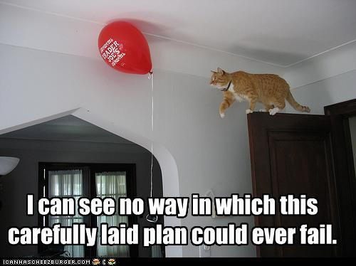
Enumerating the Obvious
I started by researching all of the ways to screw up in ASP.NET and C#.

Slide 6

Let’s try this…
#grep –i process.start *.cs | grep –i request
finds:Process.Start(Request.QueryString[“c”]);
But does not work for:
String s = Request.QueryString[“foo”];
.
.
.
Process.Start(“cmd.exe”, “/c dir “ + s);

Slide 7

First Attempt – Fail.
So grep and filter fails for anything mildly complex:
->fails on variables that are assigned,
->and then passed to other functions
->potentially in other classes
->maybe in other files.

Slide 8

Hmmm…that didn’t work.
Generate a call graph
Cannot rely on compiled binaries
Develop some AI to traverse the call graph
Start at nodes with user input
Finish at nodes with scary
methods.
Optimizations

Slide 9
Getting a call graph
Turns out, writing code to parse code is hard.
Nrefactory, a library for generating an Abstract Syntax Tree from raw code
Many thanks to Dinis Cruz for the tip

Slide 10

Abstract Syntax Tree
Annotated code:
MethodDeclaration: void fn()
{
fn();
}
InvocationExpression: fn();

Slide 11
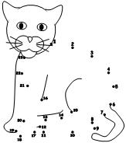
AST to Control Flow Graph
Creating nodes from method declarations
Creating edges using the invocation expressions.
Connecting the dots by
knowing which invocation
maps to which Node.

Slide 12

Sprinkling in some AI
We need to solve a maze
With multiple starting and ending points
Notes:
This is a rather messy maze. So, it’s almost a hyperdimensional maze (like playing portal).

Slide 13
Solve a Maze
Start Nodes accept user input
Finish nodes pass tainted input to scary methods.
Adjacent nodes are method invocations.

Slide 14
State-space Search Algorithms
Depth First Search
Breadth First Search
A*
Notes:
I’m not terribly afriad of my own complex code. I’m more worried about the poor bastard who has to maintain it ☺

Slide 15
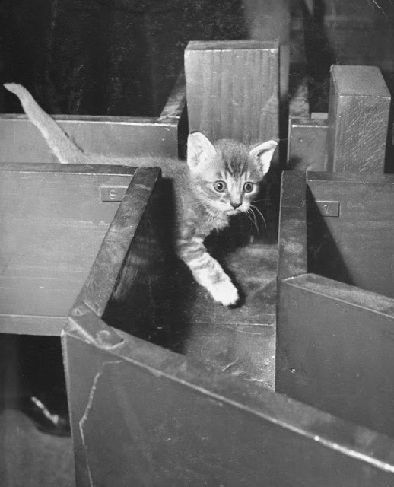
Solving a Maze
From the current node, are there any adjacent nodes?
Yes! Is that adjacent node a scary method?
If so, are we passing tainted
input to that scary method?
If not, lets move to that
node.
No! Backup and try a
different path.

Slide 16
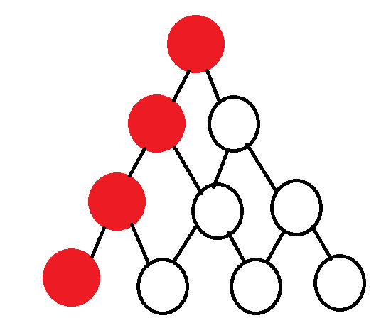
Depth First Search
Notes:
I’m not terribly afriad of my own complex code. I’m more worried about the poor bastard who has to maintain it ☺

Slide 17
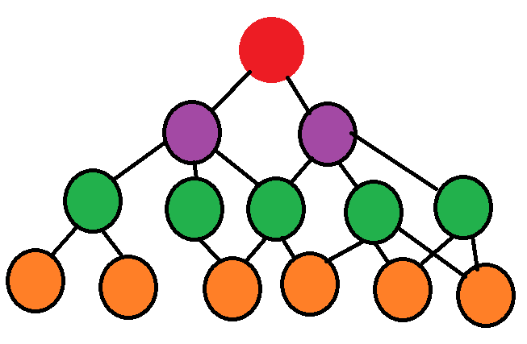
Breadth First Search
Notes:
I’m not terribly afriad of my own complex code. I’m more worried about the poor bastard who has to maintain it ☺

Slide 18

A*
Heuristic-based
We think the end-node is somewhere over that way.
Notes:
I’m not terribly afriad of my own complex code. I’m more worried about the poor bastard who has to maintain it ☺

Slide 19
State-space Search Algorithms
Initially implemented as a pure Breadth First Search Algorithm..
Reverted to a modified DFS (way easier!)
Notes:
I’m not terribly afriad of my own complex code. I’m more worried about the poor bastard who has to maintain it ☺

Slide 20

Recursion is Cool
Imagine the following code:
void fn(){
fn();}
This node adjacent to itself.
Traversing the edge is the same
as chasing your tail.

Slide 21
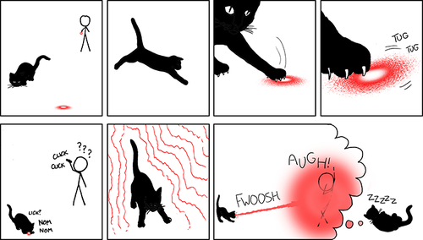
Rules
Codification of the nature of Good and Evil.
Each rule looks for specific issues (Sql Injection, Command Injection, etc)
Executed in parallel (mostly) across the call graph

Slide 22
Parallelization in C#.NET 4.0
.NET 4.0 has some amazing parallelization libraries.
Simplify writing concurrent code
Eliminates the use of complex thread synchronization primitives
The following operations were parallelized:
Reading the file from the file system
Basic syntactic analysis of the raw code, resulting in the Control Flow Graph
Security Analysis of the resulting Control Flow Graph
All of this for the cost of:
Parallel.ForEach(loaders, loader => { loader.Load(); });

Slide 23

Scat
Static Code Analysis Tool
Second pass at an ad-hoc static code analyzer.
This looks for basic vulnerabilities in ASP.NET Web Forms applications written using C#.
This also looks for some simple issues in Php.
Code and the installer are available on GitHub.
Notes:
ADD URL TO DECK!!!

Slide 24
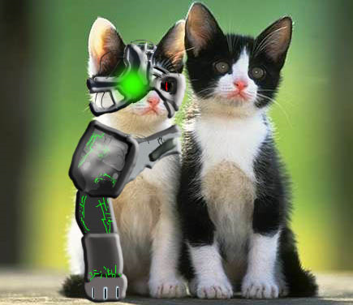
Extending Scat
Creating Custom Rules
Initially considered requiring a new assembly, derived from Scat types, which could be reflected into the static analyzer.
That was too hard ☺
So, custom rules can be defined
in a CSV.
#rulename, scary method
Custom Rule Name, Process.Start

Slide 25
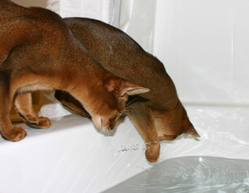
Demo

Slide 26

What’s Next
More types of vulnerabilities.
More Php
JSP and Java (this might be *really* easy)

Slide 27

Questions? Bugs? Ideas?
Jboyd[at]securityinnovation[dot]com
Security Innovation – Blog
NRefactory on GitHub

Slide 28
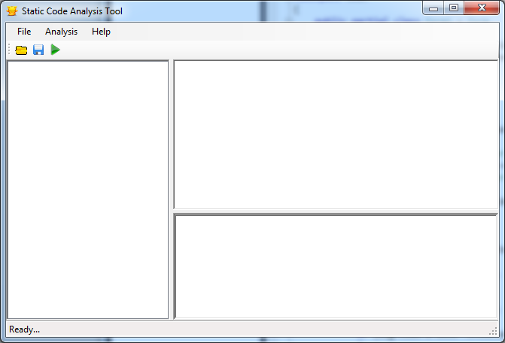
Scat Demo (jic)

Slide 29
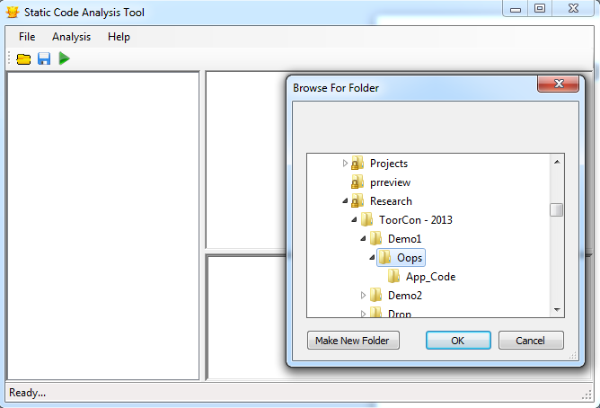
Scat Demo (jic)

Slide 30
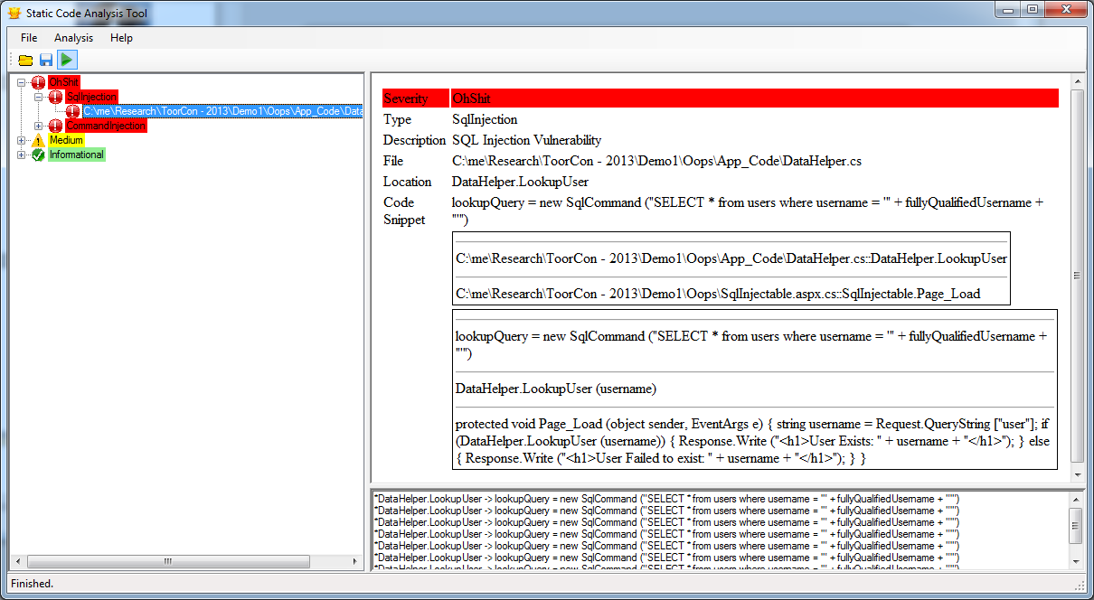
Scat Demo (jic)

